Slide 1


Find a Doctor OMIS 652 – Group Project Group - F

Slide 2
Team
Bindu Priya Aluru (Z1941394)
Manoj Kumar Sannapaneni (Z1908689)
Meghana Movva (Z1939048)
Nikitha Katragadda (Z1937851)

Slide 3
Introduction
Mission : To provide high-quality, trusted, and accessible healthcare
Find a doctor is the start of a better health care journey helping people to find and book doctors of their choice ensuring requirements are attended in confidential and caring manner
Empowering our users with the most accurate, comprehensive and curated information enabling them to make better healthcare decisions is our sole reason for being
Users can locate the medical professionals near by and appointments can be made instantly that work with one's schedule

Slide 4
Consultation with trusted doctors across many specialties can be availed through this application
Subscription-based health plans, a feature which is maintained by admin staff provides unlimited consultations according to the patient's convenience
We understand healthcare goes beyond signs, symptoms, diagnosis,
and treatment. It’s about the deep connection between doctors and patients that leads to continuous care and sustained, better outcomes
Each time a patient finds the right doctor, we build a healthier society- take the hassle out of health care

Slide 5
Entities
User
Hospital
Patient
Doctor
Appointment
Bill
Payment
Treatment

Slide 6
Entities (Contd…)
Admin Staff
Service
Service Appointment
Report
Room
Clinical Staff

Slide 7
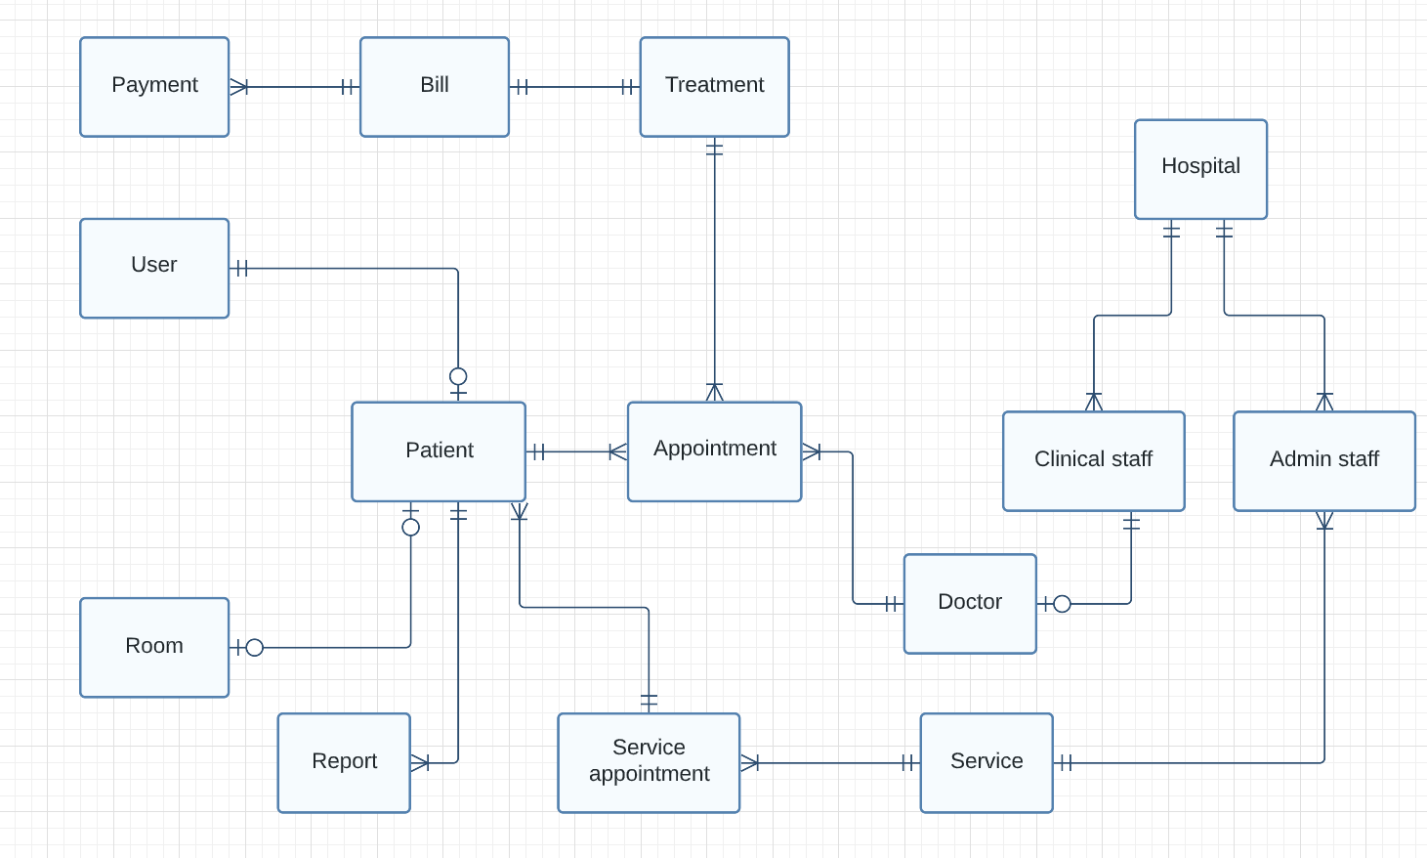
E-R Diagram

Slide 8
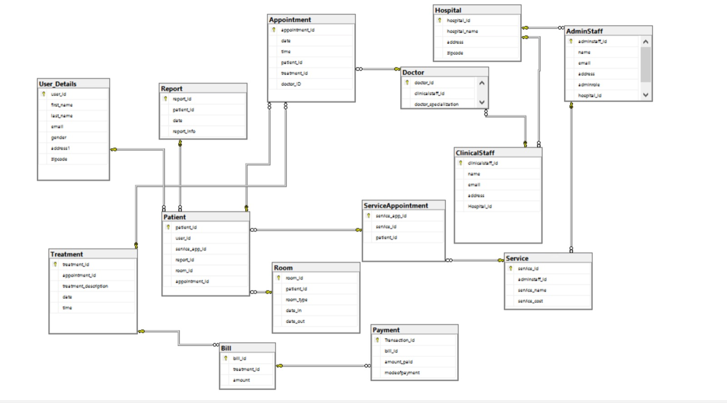
Database Diagram

Slide 9
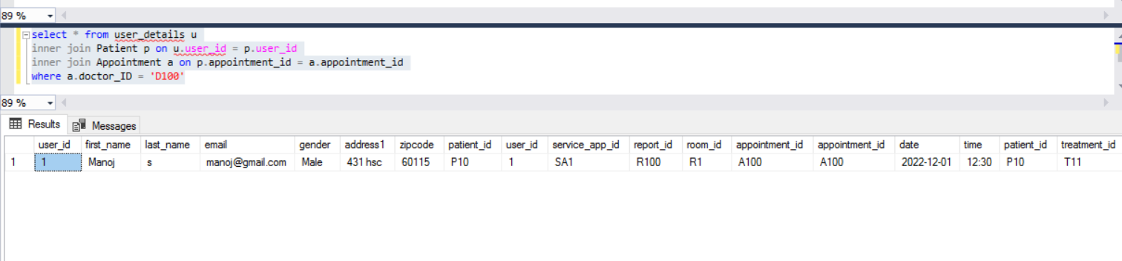
Query #1
Display the details of patient who has an appointment with doctor D100

Slide 10
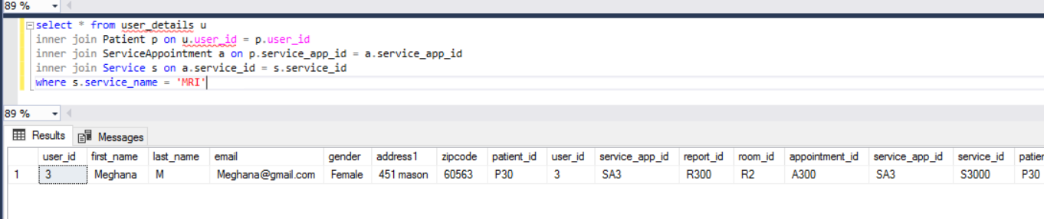
Query #2
Name of patients who availed the service of MRI scan

Slide 11
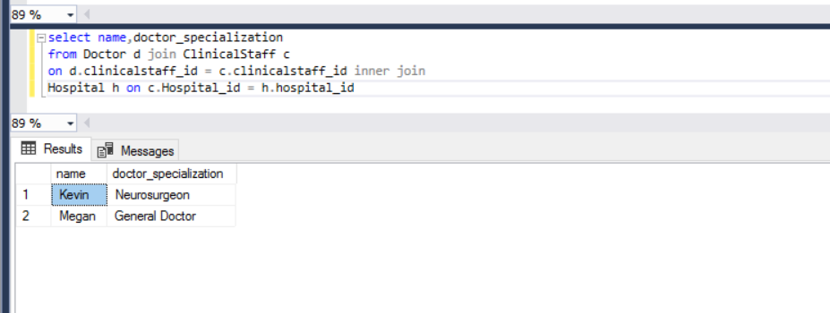
Query #3
Display the list of different doctors and their specializations

Slide 12
QUESTIONS?

